Slide 1
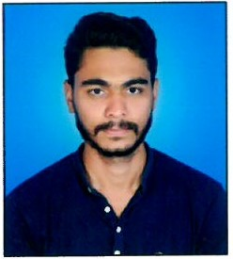
Rushikesh V Dakre
Analyst/Software Engineer
Bachelor of Technlogy, Civil
: 2015 - 2019
Skills
Angular | Components, Services, Modules, Routing, Forms And Validation.
UI Tech | HTML 5 & CSS 3,JavaScript, ES6 & TypeScript , Bootstrap
Database | MongoDB , SQL Basics of SQL.
Tools | Git
Add On skills | Communication Skills, Team management
Mumbai
RUSHIKESH.VINOD-DAKRE@CAPEGEMINI.COM
+91 8999508172
A4
Full Stack Developer
Understanding of HTML5, CSS, Javascript , and Angular
Understanding of React.
Full Stack developer with Angular.
Proficient in creating Single page Web Application in Angular with Authentication with routing.
Hands on experience in developing web pages using HTML5, CSS3, Object Oriented Java script.
. Currently completing Microsoft AWS certification course
Plant sapling management system –
Study of plant sapling with HTML5, CSS, Bootstrap
and Angular.

